Slide 1



Digital Image Processing
Lane and Object Detection
Tasneem Essmat Metwally 1807431
Youssef Hussien Mahmoud 1805437
Zyad Sobhy Mohamd 1804802

Slide 2

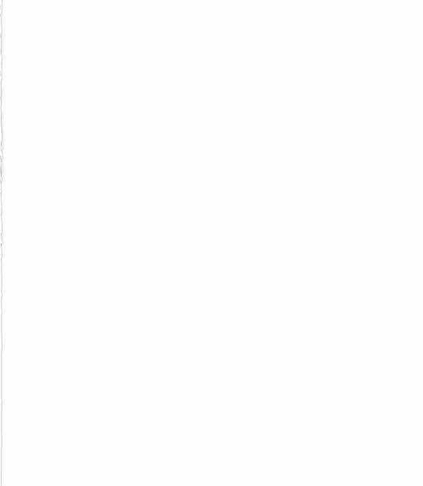
Contents
-Camera Calibration
-Perspective Transformation
-Binary thresholding
-Lane Detection
-Curvature Calculation
-Yolo Algorithm
-Other Algorithm

Slide 3
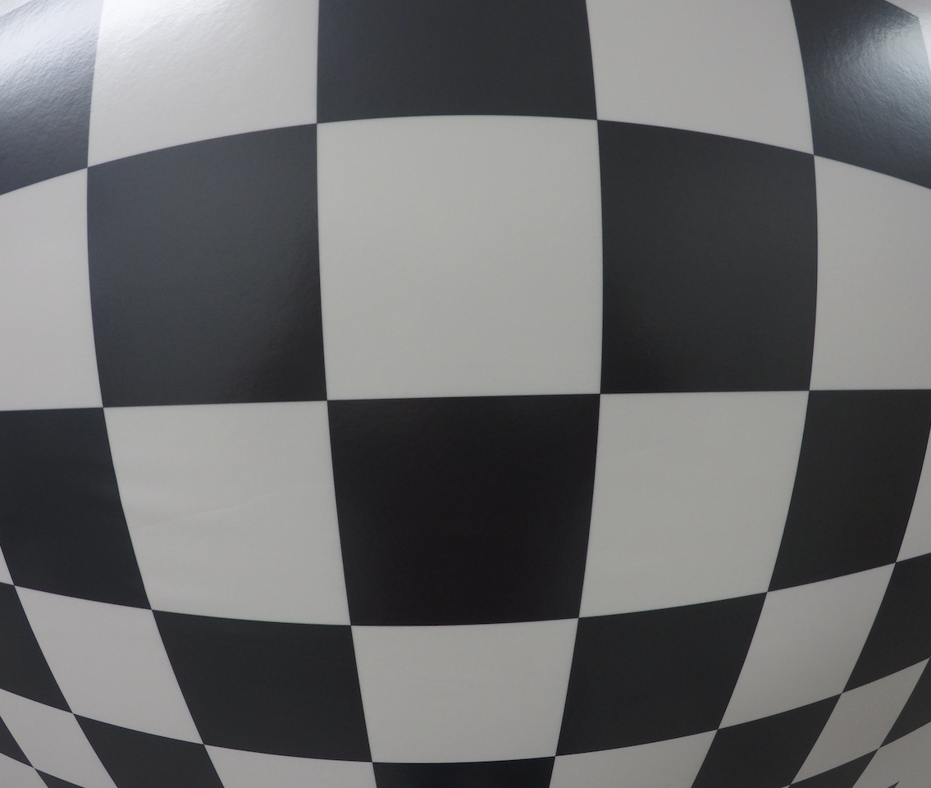
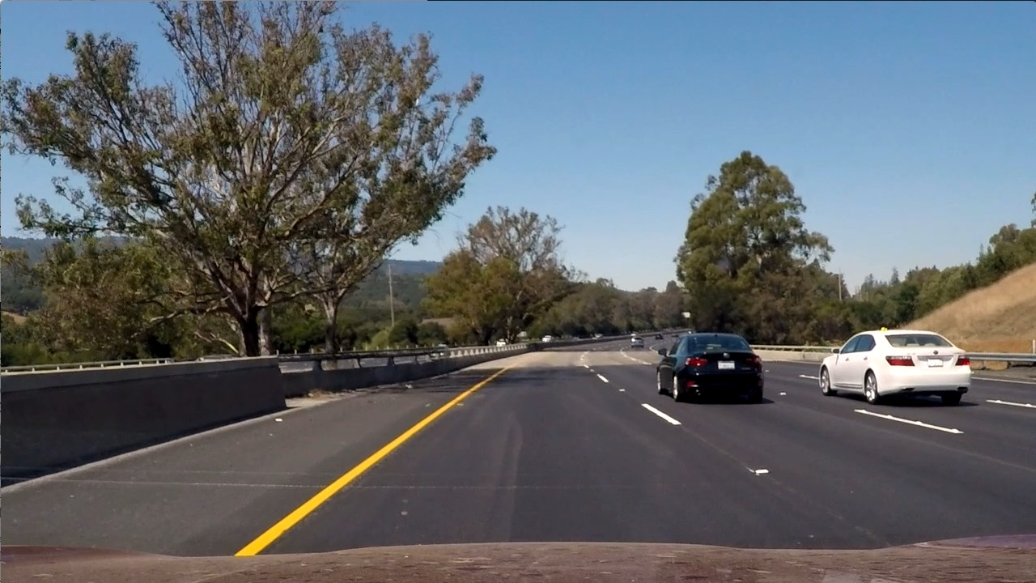
Camera Calibration
Distortion Types
Distortion coeffients
Undistorting using Chessboard

Slide 4
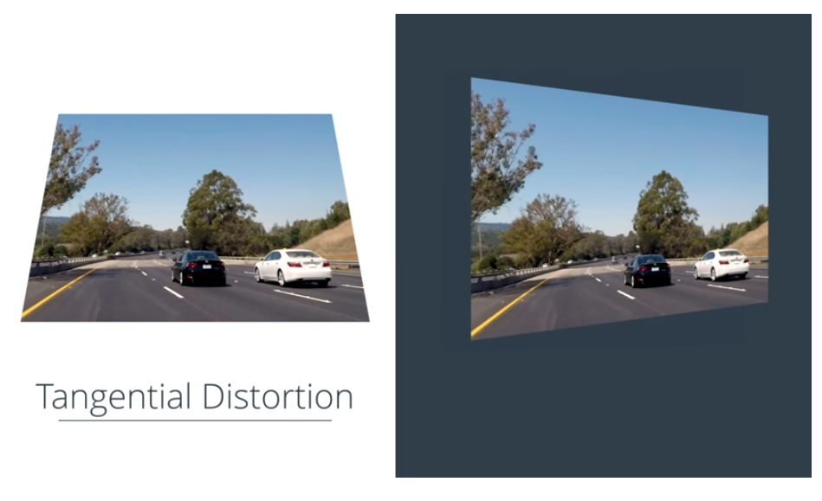
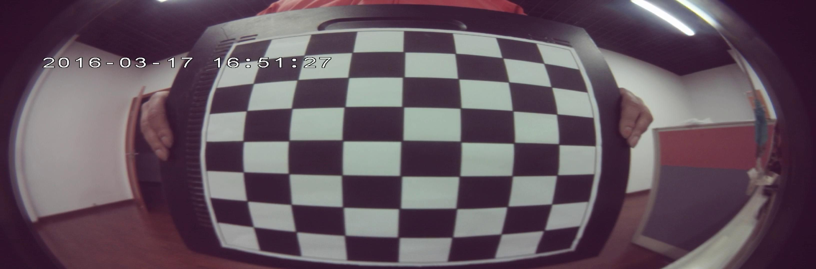
Distortion Types
Radial Distortion
Tangential distortion
More Curved edged
This makes an image look tilted so that some objects appear farther away or closer than they actually ar

Slide 5
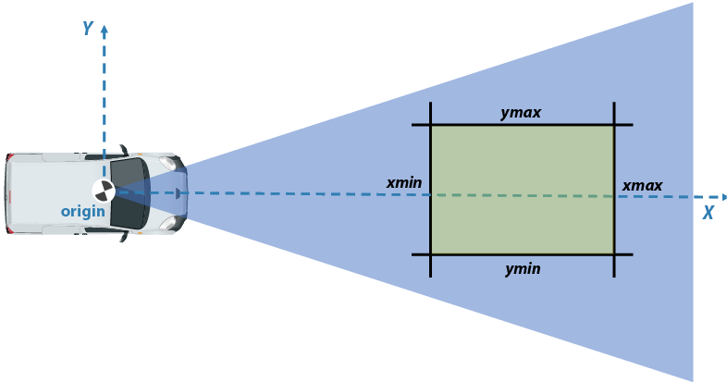
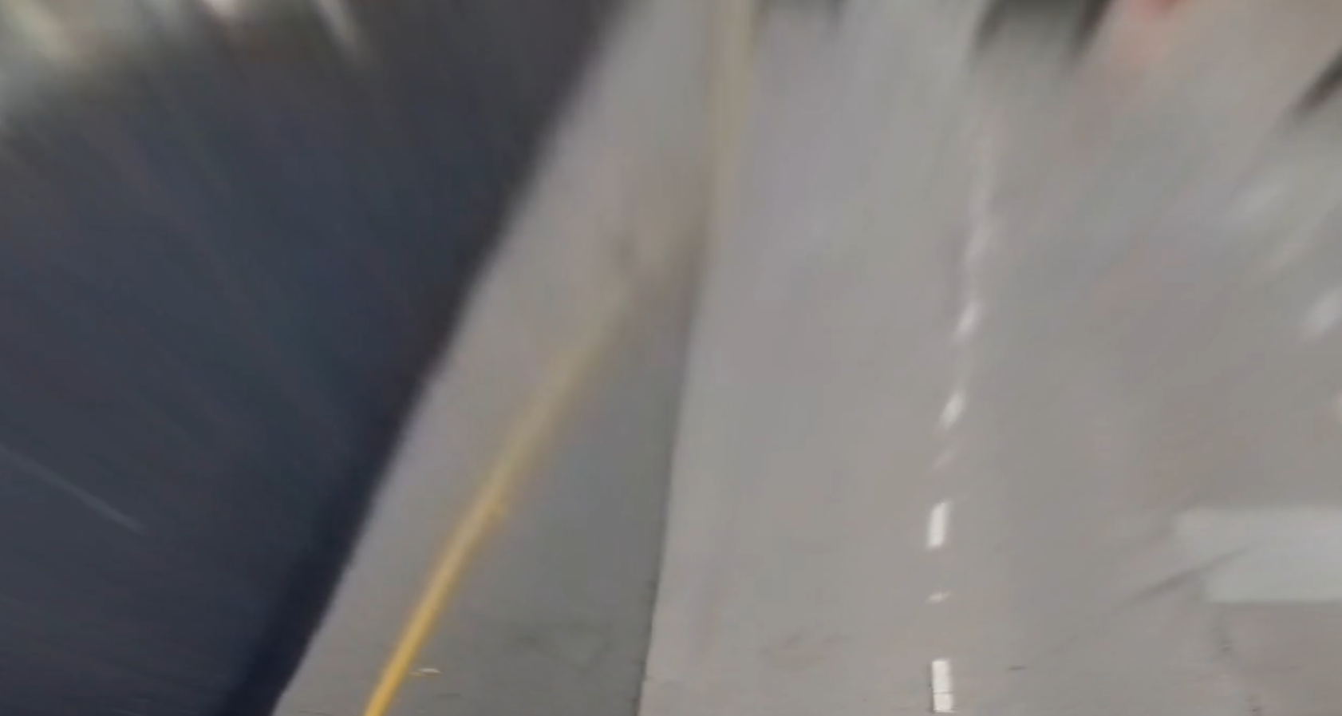
Perspective Transformation
Bird Eye View
Mapping Points
Useful for Curvature Detection

Slide 6
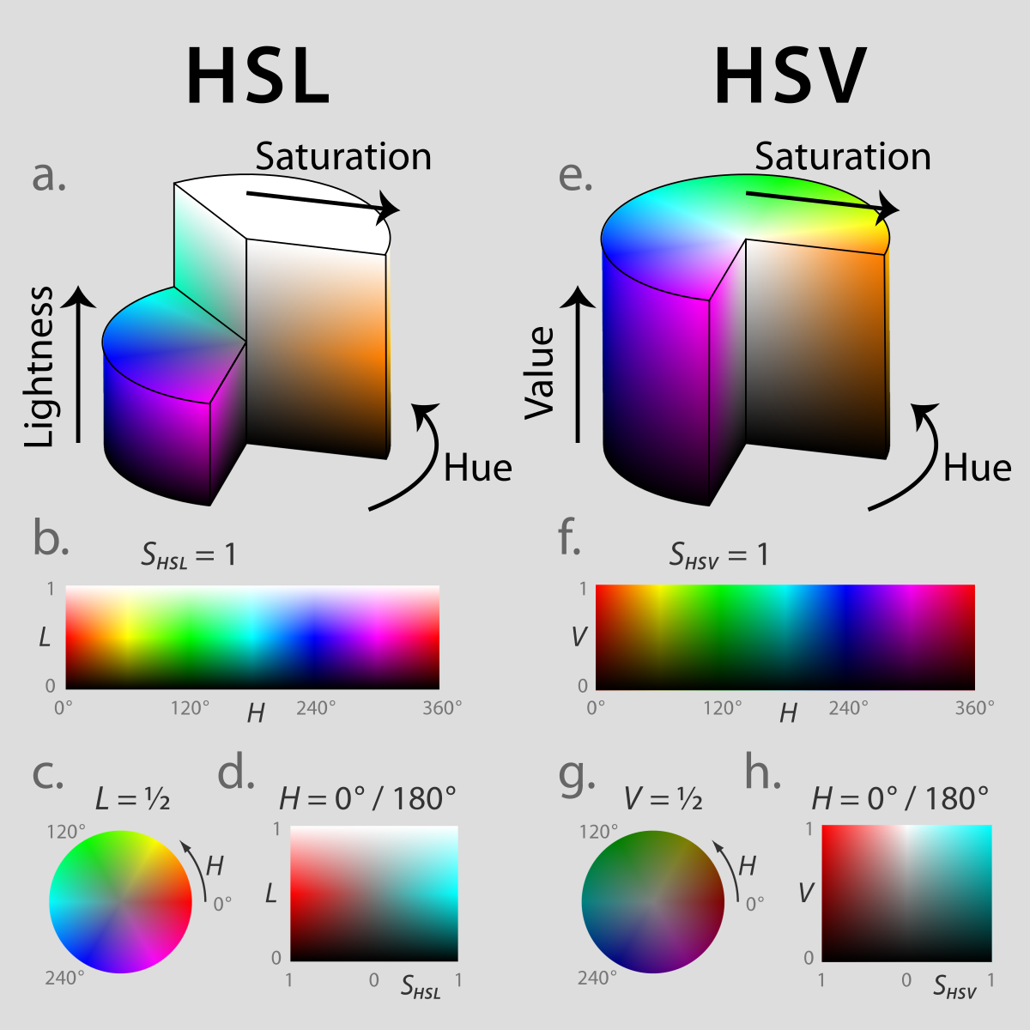
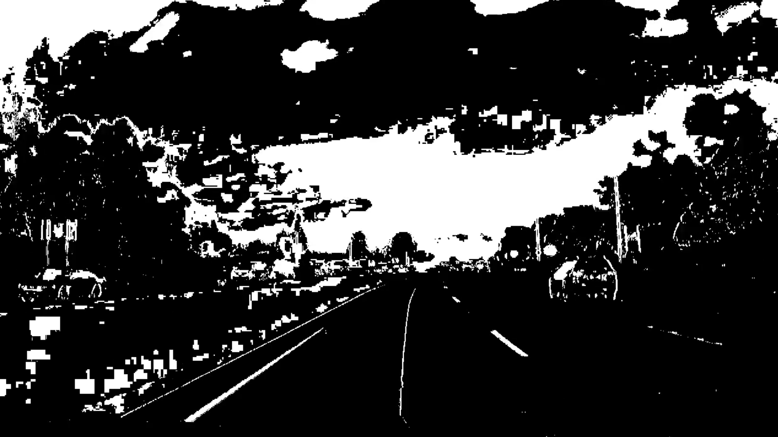
Binary Thresholding
Sobel
HLS
White Binary

Slide 7
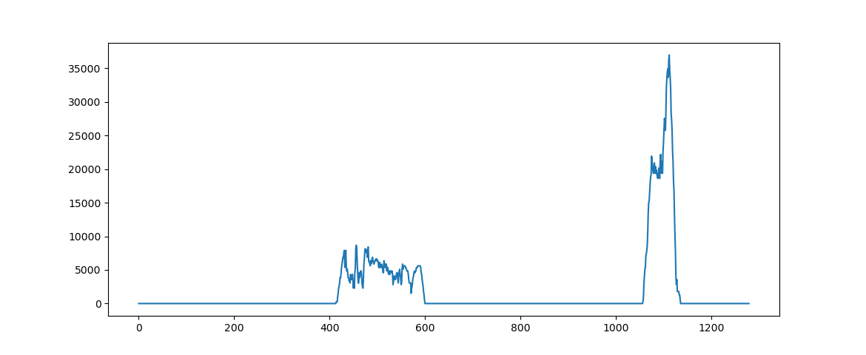
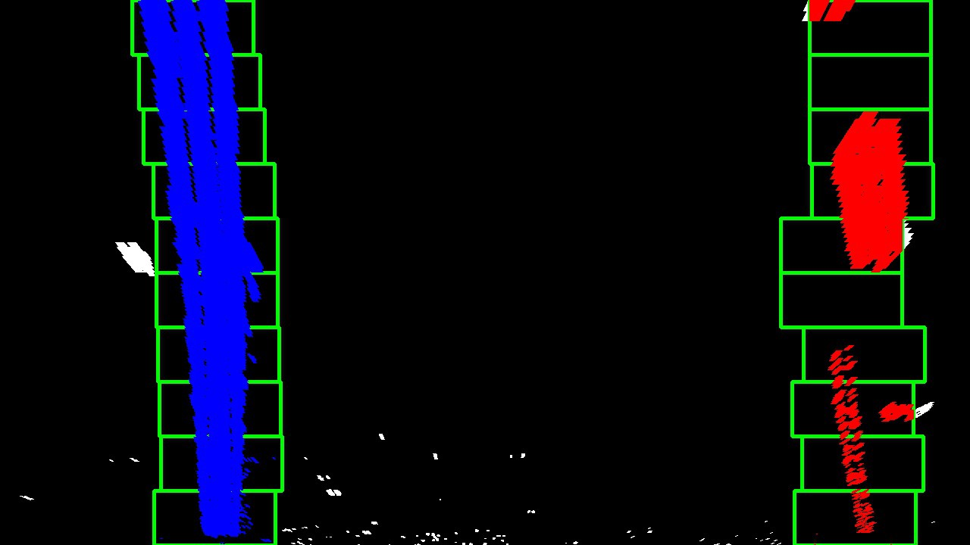
Lane Detection
Histogram
Sliding Window

Slide 8

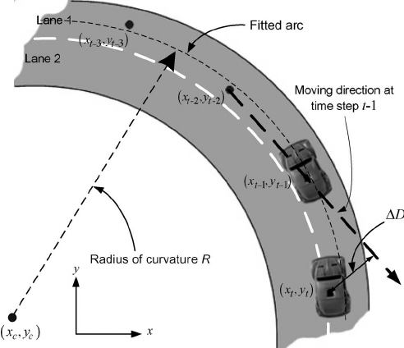
Curvature Calculation
Vehicle Position
Radius Calculation

Slide 9
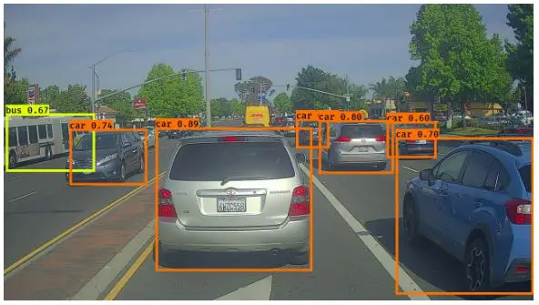
Object Detection
It’s a phenomenon in computer vision that involves the detection of various objects in digital images or videos. Some of the objects detected include people, cars, chairs, stones, buildings, and animals.
This phenomenon seeks to answer two basic questions:
What is the object? This question seeks to identify the object in a specific image.
Where is it? This question seeks to establish the exact location of the object within the image

Slide 10
YOLO You Only Look Once
We will use YOLO for object detection
Why YOLO?
Speed: This algorithm improves the speed of detection because it can predict objects in real-time.
High accuracy: YOLO is a predictive technique that provides accurate results with minimal background errors.
Learning capabilities: The algorithm has excellent learning capabilities that enable it to learn the representations of objects and apply them in object detection

Slide 11
What is YOLO?
This is an algorithm that detects and recognizes various objects in a picture (in real-time)
Object detection in YOLO is done as a regression problem and provides the class probabilities of the detected images.
YOLO algorithm employs convolutional neural networks (CNN) to detect objects in real-time
The algorithm requires only a single forward propagation through a neural network to detect objects
The CNN is used to predict various class probabilities and bounding boxes simultaneously!

Slide 12
How Does It Work?
YOLO algorithm works using the following three techniques:
Residual blocks
Bounding box regression
Intersection Over Union (IOU)

Slide 13
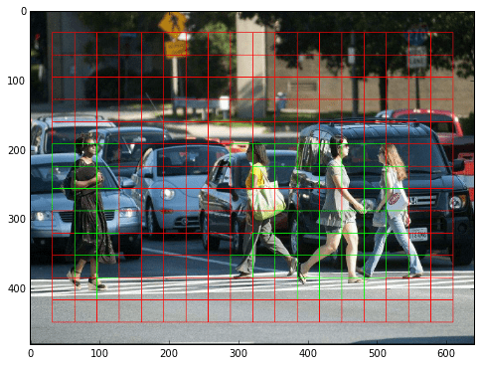
Residual blocks
First, the image is divided into various grids. Each grid has a dimension of S x S
There are many grid cells of equal dimension. Every grid cell will detect objects that appear within them.
For example, if an object center appears within a certain grid cell, then this cell will be responsible for detecting it.

Slide 14
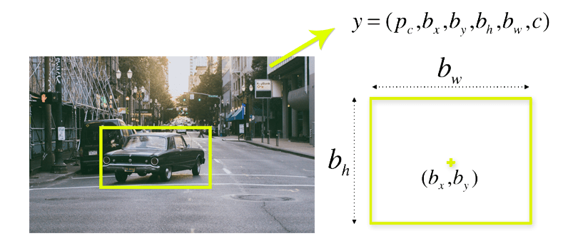
Bounding box regression
A bounding box is an outline that highlights an object in an image.
Every bounding box in the image consists of the following attributes:
Width (bw)
Height (bh)
Class (for example, person, car, traffic light, etc.)-c
Bounding box center (bx,by)

Slide 15
Intersection over union (IOU)
Intersection over union (IOU) is a phenomenon in object detection that describes how boxes overlap.
YOLO uses IOU to provide an output box that surrounds the objects perfectly.
Each grid cell is responsible for predicting the bounding boxes and their confidence scores.
The IOU is equal to 1 if the predicted bounding box is the same as the real box.
This mechanism eliminates bounding boxes that are not equal to the real box.

Slide 16
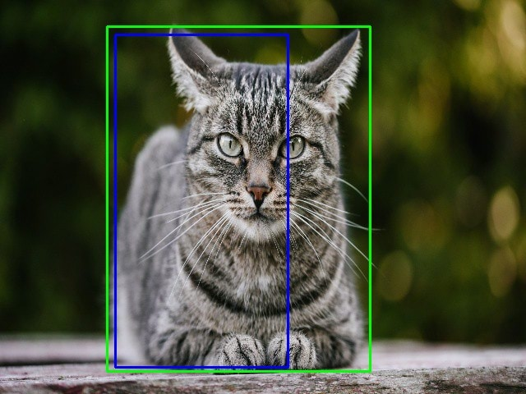
In this image, there are two bounding boxes:
one in green which is the real box
One in blue which is the predicted box
YOLO ensures that the two bounding boxes are equal!

Slide 17
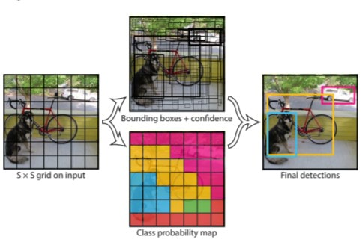
Combination of the three techniques
The following image shows how the three techniques are applied to produce the final detection results.
the image is divided into grid cells.
Each grid cell forecasts B bounding boxes and provides their confidence scores.
The cells predict the class probabilities to establish the class of each object.

Slide 18
For example, we can notice at least three classes of objects: a car, a dog, and a bicycle. All the predictions are made simultaneously using a single convolutional neural network.
Intersection over union ensures that the predicted bounding boxes are equal to the real boxes of the objects.
This phenomenon eliminates unnecessary bounding boxes that do not meet the characteristics of the objects (like height and width).
The final detection will consist of unique bounding boxes that fit the objects perfectly.

Slide 19
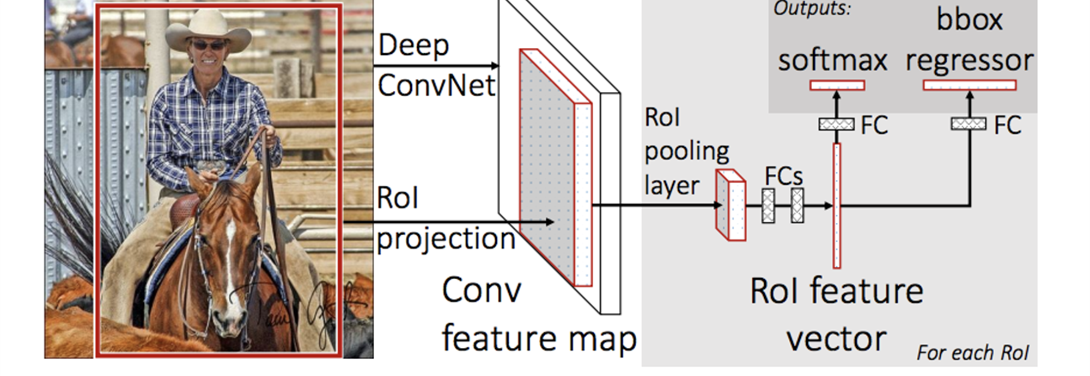
Let’s compare yolo with other competing algorithms
What is Fast R-CNN?
Fast Region-based Convolutional Network method
It uses deep convolutional networks
A Fast R-CNN network takes as input an entire image and a set of object proposals.
The network first processes the whole image with several convolutional (conv) and max pooling layers to produce a conv feature map.
Then, for each object proposal a region of interest (RoI) pooling layer extracts a fixed-length feature vector from the feature map.
Each feature vector is fed into a sequence of fully connected (fc) layers that finally branch into two sibling output layers: one that produces softmax probability estimates over K object classes plus a catch-all “background” class another layer that outputs four real-valued numbers for each of the K objectclasses. Each set of 4 values encodes refined bounding-box positions for one of the K classes.
Fast-RCNN extracts all the regions first and runs selective search just once. This way it reduces time complexity by a large factor

Slide 20
Fast R-CNN vs YOLO
Fast R-CNN
YOLO
Use regions to localize the object within the image
The network does not look at the complete image. Instead, parts of the image which have high probabilities of containing the object
Region proposals become bottlenecks in Fast R-CNN algorithm affecting its performance.
A single convolutional network predicts the bounding boxes and the class probabilities for these boxes.
The limitation of YOLO algorithm is that it struggles with small objects within the image and objects close to each other, for example it might have difficulties in detecting a flock of birds. This is due to the spatial constraints of the algorithm.

Slide 21
It is significantly slower than YOLO
Low accuracy.
Improved detection results compared to Fast R-CNN
It makes classification and bounding box regression at the same time.
YOLO is clearly the most efficient

